Slide 1
Angular
Modules, Components, Templates and Metadata
Lecture 2
By James(Jin) Wang
09/01/2019

Slide 2
Outline
ES Module
Angular Modules
Components
Templates
Metadata

Slide 3
ES Modules
  We assemble our application from modules.
  A module exports an asset such as a Service, Component, or a shared value

Slide 4
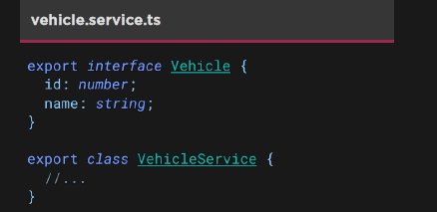
ES Modules
  Exporting modules:
  We assemble our application from modules.
  A module exports an asset such as a Service, Component, or a shared value

Slide 5
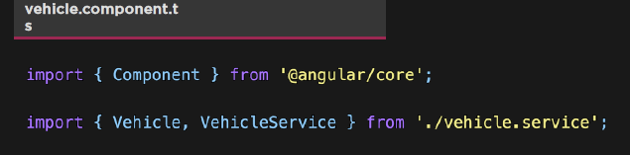
ES Modules
  Importing modules:
  Modules and their contents can be imported using the import keyword
  We import the Vehicle and VehicleService using destructuring

Slide 6
Angular Modules
  We use NgModule to organize our application into cohesive block of related functionality

Slide 7
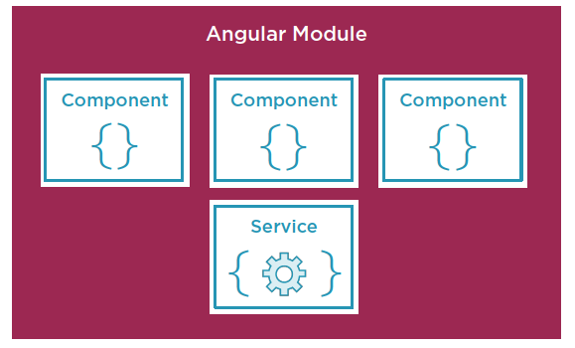
Angular Modules
  Angular Modules Organize Functionality:

Slide 8
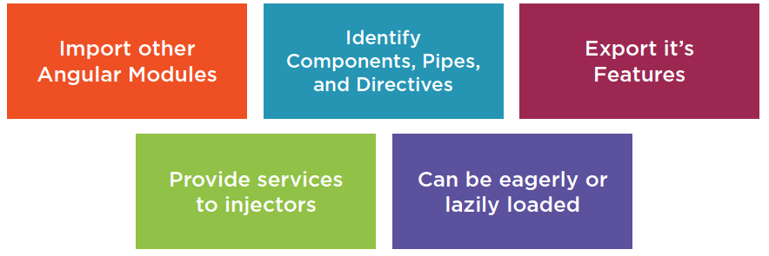
Angular Modules
  Roles of Angular Modules:

Slide 9
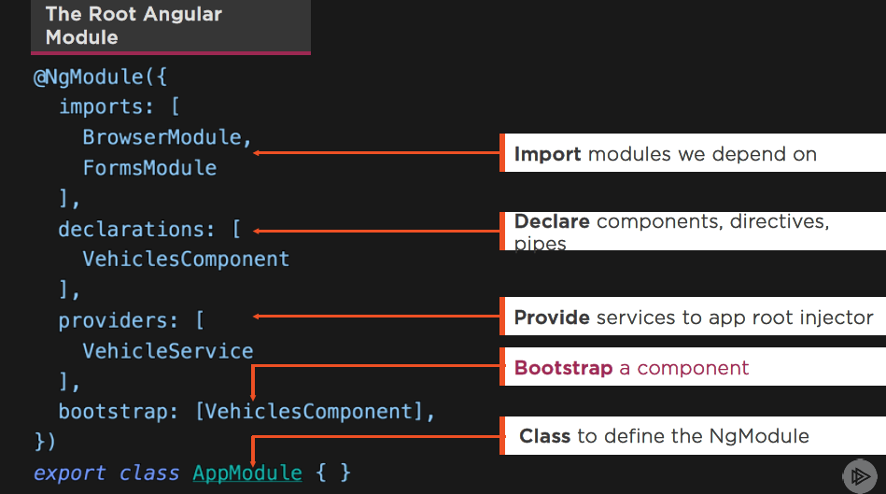
Angular Modules

Slide 10
Components
  A Component contains application logic that controls a region of the user interface that we call a view

Slide 11
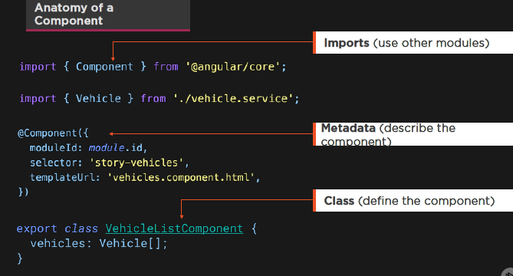
Components

Slide 12
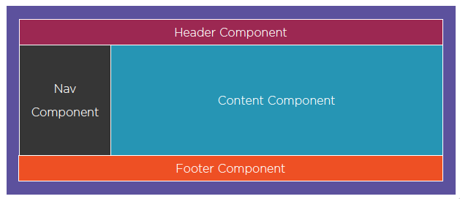
Components
  Assembling Our App from Components:

Slide 13
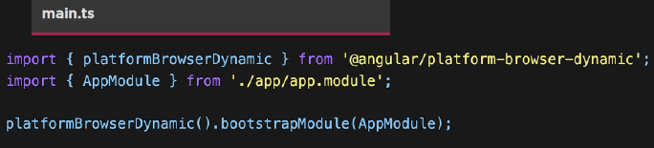
Components
  Bootstrapping a Component:
  Entry point for the app
  This is where we start

Slide 14
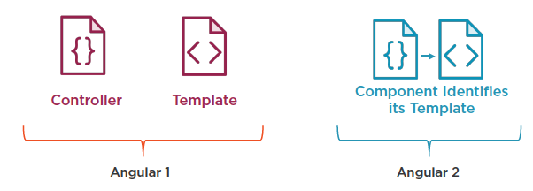
Components
  Comparing Angular 1 to Angular 2+:

Slide 15
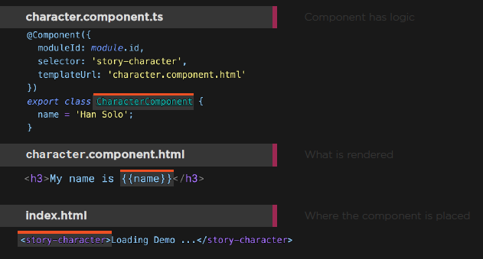
Components

Slide 16
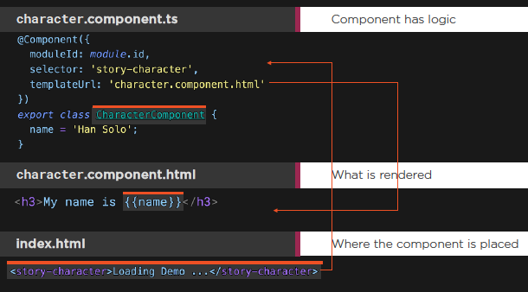
Components
  Demo: Components

Slide 17
Templates
  Templates are the View:
  Templates are mostly HTML, with a little help from Angular. They tell Angular how to render the Component.

Slide 18
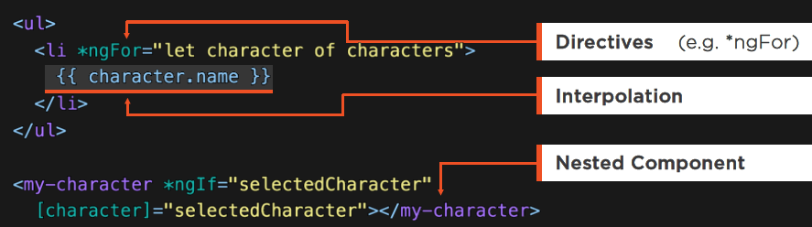
Templates
  Templates:
  HTML
  Directives, as needed
  Template Binding Syntax

Slide 19
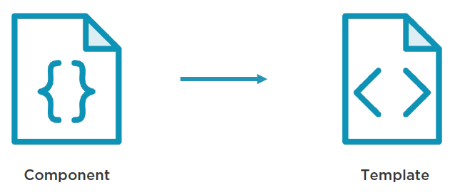
Templates
  Connecting the Component to its Template:

Slide 20
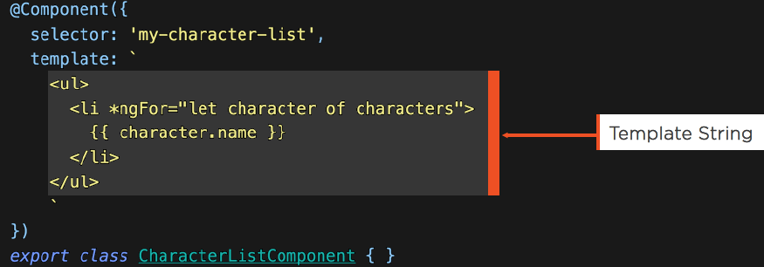
Templates
  Inline Templates:
  Template defines an embedded template string
  Use back-ticks for multi-line strings

Slide 21
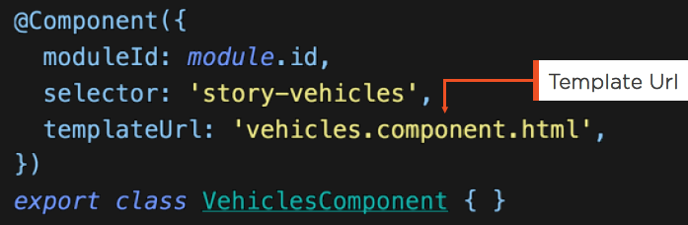
Templates
  Linked Templates:
  templateUrl links the Component to its Template

Slide 22
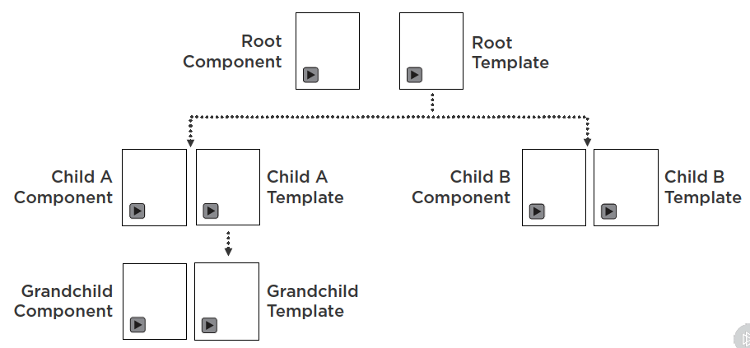
Templates
  Templates Contain Other Components:

Slide 23
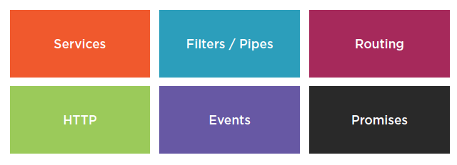
Many Angular 1 Concepts Translate

